Slide 1
CONTROL FLOW INTEGRITY IN LINUX
Saarthak Mahajan

Slide 2
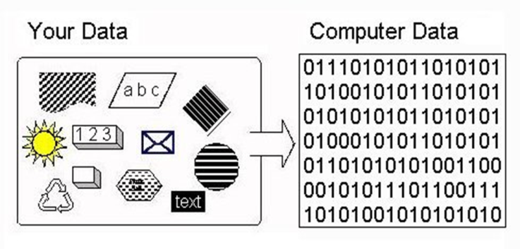
INFORMATION & IT’S SECURITY
Information is the collection of meaningful data stored in a computer in binary form.
In today’s world of Big Data, the information stored in Data centres needs to be secured .
Information security is the practise of preventing unauthorized access of information that may not be intended to be publicly or freely available.

Slide 3
VULNERABILITY
A vulnerability is a weakness which allows an attacker to reduce a system's information protection.
Vulnerability is the intersection of three elements: a system susceptibility or flaw, attacker access to the flaw, and attacker capability to exploit the flaw.
To exploit a vulnerability, an attacker must have at least one applicable tool or technique that can connect to a system weakness.

Slide 4
TYPES OF VULNERABILITIES
Physical environment of the system
Administration procedures and security measures within the organization
Hardware
Software - Buffer Overflows, Code Injection Vulnerability
Communication equipment and facilities

Slide 5
EXECUTION OF A PROGRAM
Programs in a computer are executed sequentially
in the form of Instructions . The usual flow of a
program is sequential and depends on the type
of instruction encountered.
Normal execution of a program can be interrupted
by changing the flow of a program and taking the
flow elsewhere.
Instruction Pointer(IP) is used to store the address of the
next instruction to be executed. In other words,
Instruction Pointer enforces execution of program in
a proper sequential flow and manner.
ELF(Executable and Linkable Format ) is the format of
binary executable files in Linux and other Unix based
operating systems.

Slide 6
CONTROLLING THE EIP REGISTER
EIP is a register in x86 architectures (32bit). It holds the “extended instruction pointer" for the stack. In other words, it tells the computer where to go next to execute the next command and controls the flow of a program.
In keeping with the naming convention, the Extended Instruction Pointer register was referred to as EIP.
Most often, the correct value isn't merely EIP, but CS:EIP, because the value of EIP remains an offset from some starting location which is defined by the code selector.
We cannot directly access or change the instruction pointer. However, instructions that control program flow, such as calls, jumps, loops, and interrupts, automatically change the instruction pointer.

Slide 7
ADDRESS SPACE LAYOUT RANDOMIZATION(ASLR)
In a nutshell, the idea behind ASLR is randomizing the process memory space in order to prevent the attackers from finding the addresses of functions they might require to successfully complete the exploit.
Linux introduced ASLR with kernel 2.6.12 back in 2005.
ASLR randomly arranges the address space positions of key data areas of a process, including the base of the executable and the positions of the stack, heap and libraries.
Address space randomization hinders some types of security attacks by making it more difficult for an attacker to predict target addresses.

Slide 8
DATA EXECUTION PREVENTION(DEP)
It marks memory regions as non-executable, such that an attempt to execute machine code in these regions will cause an exception. It makes use of hardware features such as the NX bit (no-execute bit).
DEP/NX alone does not provide perfect protection against all memory-based vulnerabilities, but as with ASLR technologies, it can provide advanced protection on memory based vulnerabilities.
It stops an attacker from being able to directly execute code from the stack, heap, and other non-code memory regions.

Slide 9
ASLR & DEP
ASLR makes it difficult for malicious users to find target blocks of code for buffer overflow attacks and other code-based attacks because the processes are randomly assigned to memory in the computer.
DEP is designed to prevent executing data as if it were blocks of code.
Many of today’s applications do not support ASLR because those applications need to be specially linked to take advantage of this feature. Applications that support ASLR use slightly more RAM than those that don’t.
Older operating systems (e.g., Windows XP) do not support DEP.
ASLR & DEP are most effective when used together.
Together they are not a silver bullet. Memory module mapping can bypass ALSR, and Return-Oriented Programming (ROP) chaining can bypass DEP.

Slide 10
RETURN ORIENTED PROGRAMMING(ROP)
ROP is a computer security exploit technique that allows an attacker to execute code in the presence of security defences such as non-executable memory (DEP), ASLR.
In this technique, an attacker gains control of the call stack to hijack program control flow and then executes carefully chosen machine instruction sequences that are already present, called "gadgets", by manipulating return addresses.
Each gadget typically ends in a return instruction and is located in a subroutine within the existing program and/or shared library code. Chained together, these gadgets allow an attacker to perform arbitrary operations on a machine.
A typical data execution prevention cannot defend against this attack because the adversary did not use malicious code but rather combined "good“ instructions by changing return addresses; therefore the code used would not be marked non-executable.

Slide 11
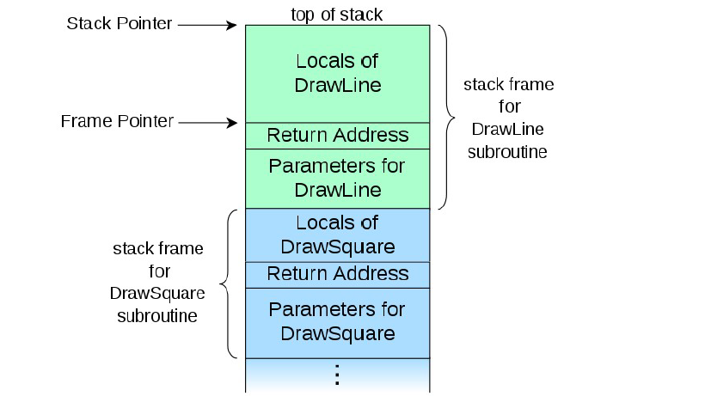
CALL STACK FOR DRAWLINE() , DRAWSQUARE()

Slide 12
DEFENCES AGAINST ROP
G-FREE Technique – It eliminates all the unaligned free branch instructions and protects the aligned ones.
OS verification of Return addresses – Ineffective.
SEHOP – Structured Exception Handler Overwrite Protection
Eliminate Return Instructions – Return Indirection – Compiler specific – Expensive.
Conclusion – There is no one technique that can eliminate ROP completely. Hence, we need a comprehensive solution .

Slide 13
CONTROL FLOW INTEGRITY
Control-Flow Integrity (CFI) restricts the control-flow of an application to valid execution traces.
CFI enforces this property by monitoring the program at runtime and comparing its state to a set of precomputed valid states.
If an invalid state is detected, an alert is raised, usually terminating the application.
Any CFI mechanism consists of two abstract components : the (often static) analysis component that recovers the Control-Flow Graph (CFG) and the dynamic enforcement mechanism that restricts control flows according to the generated CFG.

Slide 14
CFG IN CFI
A control flow graph (CFG) in computer science is a representation, using graph notation, of all paths that might be traversed through a program during its execution.
CFG generation takes places using both static and dynamic analysis, using source code or binary code.
CFG operates by creating a per-process bitmap, where a set bit indicates that the address is a valid destination.

Slide 15
CONTROL FLOW TRANFER PRIMER
Instructions on an architecture can be grouped into control-flow transfer instructions and computational instructions.
Control-flow transfer instructions can be further grouped into direct and indirect control-flow transfer instructions.
Indirect control-flow transfers are further divided into forward-edge control-flow transfers and backward-edge control-flow transfers.
We need to enforce CFI on forward edge control-flow transfers and backward edge control-flow transfers.

Slide 16
CFI ENFORCEMENT USING INSTRUMENTATION
Since we need to protect the forward edge and the backward edge indirect control flow instructions, CFI enforcement mechanisms exist separately for both of them.
Instrumentation refers to an ability to monitor or measure the level of a program's performance, to diagnose errors and to write trace information.
It’s of two types – Dynamic Instrumentation & Static Instrumentation.

Slide 17
DYNAMIC BINARY INSTRUMENTATION
Analysing the behaviour of a binary application at runtime through the injection of instrumentation code.
Analysing an application at runtime makes it possible to gain insight into the behaviour and state of an application at various points in execution.
This highlights one of the key differences between static binary analysis and dynamic binary analysis. Rather than considering what may occur, dynamic binary analysis has the benefit of operating on what actually does occur.
Dynamic Binary Instrumentation is done using Pin Tool supported by Linux, Windows, Android and OS X Operating systems which is actually CFI Enforcement.

Slide 18
INTEL PIN TOOL
A pin tool comprises instrumentation, analysis and callback routines.
Analysis routines are called when the code associated with them is run. Callback routines are only called when specific conditions are met, or when a certain event has occurred.
Pin performs instrumentation by taking control of the program just after it loads into the memory.
Then just-in-time recompiles (JIT) small sections of the binary code using pin just before it is run. New instructions to perform analysis are added to the recompiled code. These new instructions come from the Pin tool.

Slide 19
Instrumentation consists of two components –
1. A mechanism that decides where and what code is executed.
2. The code to execute at insertion points.
These two components are instrumentation and analysis code. Both components live in a single executable, a Pintool.
Since a Pintool works like a plugin, it must run in the same address space as Pin and the executable to be instrumented. Hence the Pintool has access to all of the executable's data.
When writing tools, it is more important to tune the analysis code than the instrumentation code. This is because the instrumentation is executed once, but analysis code is called many times.
Alternatives to Pin Tool – DynamoRIO, Valgrind.

Slide 20
FORWARD EGDE TRANSFER INSTRUMENTATION
BACKWARD EDGE TRANSFER
INSTRUMENTATION
For forward-edge transfers, the code is often instrumented with some form of equivalence check.
The check ensures that the target observed at runtime is in the set of valid targets.
If the observed target is not in that set, the program terminates.
A mechanism that enforces stack integrity ensures that any backward-edge transfers can only return to the most recent prior caller.
This property can be enforced by storing the prior call sites in a shadow stack or guaranteeing memory safety on the stack.
If the return addresses of both the original stack and the shadow stack don’t match then we know that CFI anomaly has occurred.

Slide 21
ILLUSTRATION OF PIN TOOL
It supports the Android, Linux, OS X and Windows operating systems and executables for the IA-32, Intel(R) 64 and Intel(R) Many Integrated Core architectures.
Used Pin Tool on Ubuntu 17.04 , kernel 3.19 – IA64.
The aim was to instrument programs not only with manual examples but also, modified examples that provide us with more information than the standard examples already provided in Pin that would help us more in a better and efficient way to enforce CFI.
Manual examples used –
inscount0.cpp (Simple Instruction Instrumentation)
inscount1.cpp (Trace Instrumentation)
itrace.cpp ( Instruction Address Instrumentation)
pinatrace.cpp ( Memory Reference Instructions) – R/W

Slide 22
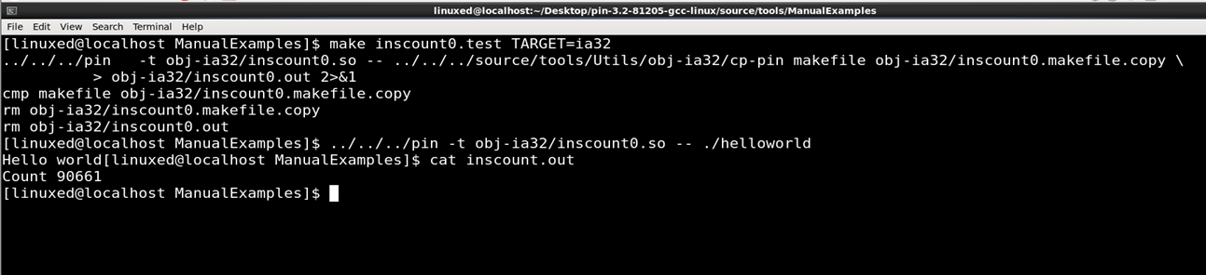
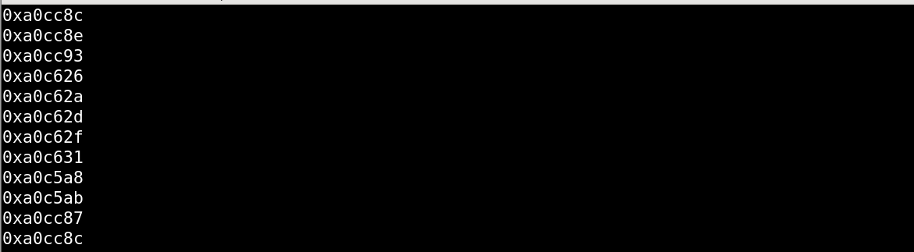
INSCOUNT0.CPP – SIMPLE INSTRUCTION COUNT
ITRACE.CPP – INSTRUCTION ADDRESS INSTRUMENTATION

Slide 23
ENFORCING CFI BY INSTRUMENTATION
We are aware that the files or programs that are used for instrumentation are written in C++, so it is possible to modify the program all together to create a new example.
The modification can be done with the use of API’s that are provided in Pin Tool’s module.
Instrumentation with these self-created examples happens normally, the only difference lies in the information we get out from that Instrumentation process and we have full control over it.

Slide 24
TO COUNT THE NO. OF CALL, RETURN & JUMP INSTRUCTIONS.
We used three standard functions provided in the Generic Inspection API.
INS_IsCall(INS ins)
INS_IsRet(INS ins)
INS_IsBranch(INS ins)
All these three functions return a Boolean value .
We can incorporate them together or individually in our new example depending upon the information we need.

Slide 25
VERIFYING THE INTEGRITY OF CALL STACK(SHADOW STACK)- BACWARD TRANSFERS
Shadow Stack is a mechanism for maintaining control-flow integrity by mitigating return address overwrites such as those seen during exploitation of a stack buffer overflow.
Store the legitimate return address (that is, the address of the instruction after the call), and on returns, check before actually returning.
A stack buffer overflow would be adequate to overwrite the return address on the stack, but not the shadow stack's record of the return address.
The return address will be checked from the shadow stack and if it doesn’t match, appropriate action can be taken.

Slide 26
OBSERVATIONS
When we run the instrumentation code against bin/ls or any other program, ideally we should not get any error or CFI anomaly.
But we observe that at some places the return addresses from the shadow stack and the original stack don’t match giving us an indication that there’s a CFI breach.
There are some exceptions due to which the return addresses of a Caller aren’t pushed on to the stack. The exceptions are -
1. Long Jump & Set Jump
2. Unix Signals and Lazy Bindings
3. C++ Exceptions
These exceptions can be handled by making proper adjustments to our instrumentation code.

Slide 27
OVERHEAD CALCULATIONS
 | WITHOUT INSTRUMENTATION | WITH INSTRUMENTATION (ALLC.SO) | WITH INSTRUMENTATION (SHADOWSTACK.SO)
T.E.T for CZF | 73.705 seconds | 81.330 seconds | 81.441 seconds
T.E.T for XZF | 16.887 seconds | 26.580 seconds | 27.054 seconds

Slide 28
OBSERVATIONS
We observe that the execution times are in the following order in both, Compression & Decompression –
WITHOUT INSTRUMENTATION < ALLC.SO < SHADOW_STACK.SO
From the above observations, we conclude the following things:-
The execution of a program with instrumentation takes more time than it’s execution without instrumentation.
The instrumentation done with shadow_stack.so takes more time than instrumentation done with allc.so since it has the additional capability of handling all the exceptions .
The overhead of the instrumentation of the pin tool with programs varies.

Slide 29
CONCLUSIONS
If implemented correctly, CFI is a strong defence mechanism that restricts the freedom of an attacker.
For the forward-edge, a strong mechanism must be considered to restrict the set of valid targets as much as possible.
For the backward edge, a context-sensitive approach that enforces stack integrity guarantees full protection.

Slide 30
THE END

